Slide 1
Performance Metrics
Data Structures Week 1
Message complexity -number of messages that are required
per CS execution by a site
Synchronisation Delay - After a site leaves the CS, it is the time required before the next site enters CS
Response Time - This is the time interval a request waits for its CS execution to be over after its request messages have been sent out .
System Throughput - Rate at which the system executes requests for the CS.
SD -synchronization delay E-avg CS execution time
System throughput= 1/ (SD+E)

Slide 2
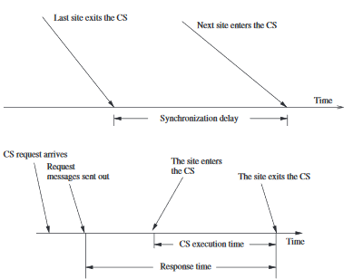
Data Structures Week 1

Slide 3
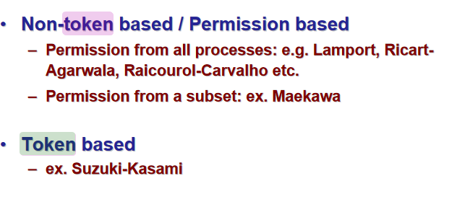
Data Structures Week 1

Slide 4
Lamport’s Algorithm for Mutual Exclusion
Lamport used his logical scalar clocks and FIFO assumption on message delivery to design an algorithm for mutual exclusion.
Also assume a bidirectional channel between each pair of processors.
Every site Si keeps a queue, request_queue_{i}, which contains mutual exclusion requests ordered by their timestamps(priority queue). The request_queue is a set of waiting processes ordered by timestamp

Slide 5
Lamport’s Algorithm for Mutual Exclusion
Requesting the critical section:
  When a site S_{i} wants to enter the CS, it broadcasts a REQUEST(ts_{i} , i) message to all other sites and places the request on request_queuei. ((ts_{i} , i) denotes the timestamp of the request.)
  When a site S_{k} receives the REQUEST(ts_{i} , i) message from site S_{i} ,places site S_{i} ’s request on request_queue_{k} and it returns a timestamped REPLY message to S_{i}.
Executing the critical section:
  Site S_{i} enters the CS when the following two conditions hold:
  L1: S_{i} has received a message with timestamp larger than (ts_{i}, i) from all other sites. note: need not be reply msg
  L2: S_{i} ’s request is at the top of request_queuei.
Notes:
Here if you put (i, ts_{i}) instead of (ts_{i} , i) then higher process ids will starve

Slide 6
Lamport’s Algorithm
Releasing the critical section:
  Site S_{i}, upon exiting the CS, removes its request from the top of its request queue and broadcasts a timestamped RELEASE message to all other sites.
  When a site S_{j} receives a RELEASE message from site S_{i}, it removes S_{i}’s request from its request queue.
  When a site removes a request from its request queue, its own request may come at the top of the queue, enabling it to enter the CS.

Slide 7
Some notable points
Purpose of REPLY messages from node i to j is to ensure that j knows of all requests of i prior to sending the REPLY (and therefore, possibly any request of i with timestamp lower than j’s request)
Requires FIFO channels.
3(n – 1 ) messages per critical section invocation
Synchronization delay = max mesg transmission time of Release msg
Requests are granted in order of increasing timestamps

Slide 8
Data Structures Week 1
Can we do away with the Release messages and manage only with request messages and reply msgs?

Slide 9
Optimisation -Ricart-Agarwala’s Algorithm
Data Structures Week 1
Removes release msg.
If Process Pj has a request
- a process Pj gives reply msg only if the process has request of higher timestamp than received request
If it has lower timestamp then give reply only after done with CS
If Process Pj has no request then give reply.
Reply message is a permission giving message
You enter CS only after receiving reply from all processes.
Notes:
Worst case btwn two sites only two msgs flow. Request msg and reply msg.
If no own request then reply. If has own request of lower ts than received request then reply after your own CS. If has own request of higher ts than received request then this higer ts acts as an ok nod so reply not needed.
How to know if I can enter CS if I have second min ts among my heap – The guy with the min ts will send reply after he is done and then I enter.
Note a reply msg automatically has higher scalarclock value that request msg since reply will be request_arrivaltime +1

Slide 10
Ricart-Agarwala’s Algorithm
Uses two types of messages: REQUEST and REPLY.
A process sends a REQUEST message to all other processes to request their permission to enter the critical section.
A process sends a REPLY message to a process to give its permission to that process.
Processes use Lamport-style logical clocks to assign a timestamp to critical section requests and timestamps are used to decide the priority of requests.
Each process p_{i} maintains a Boolean Request-Deferred array, RD_{i}, the size of which is the same as the number of processes in the system.
Initially, ∀i ∀j: Rd_{i}[j]=0. Whenever p_{i} defers the request sent by p_{j}, it sets Rd_{i}[j]=1 and after it has sent a REPLY message to p_{j}, it sets RD_{i}[j]=0.
Notes:
Removes the assumption on FIFO delivery guarantee of channels.

Slide 11
Ricart-Agarwala’s Algorithm
Requesting the critical section:
  When a site S_{i} wants to enter the CS, it broadcasts a timestamped REQUEST message to all other sites.
  When site S_{k} receives a REQUEST message from site S_{i}, it sends a REPLY message to site S_{i} if site S_{k} is neither requesting nor executing the CS, or if the site S_{k} is requesting and S_{i}’s request’s timestamp is smaller than site S_{k}’s own request’s timestamp. Otherwise, the reply is deferred and S_{j} sets RD_{j}[i]=1.
Executing the critical section:
  Site S_{i} enters the CS after it has received a REPLY message from every site it sent a REQUEST message to.
Notes:
The part in red is not needed. For Si to execute, it can execute CS when it receives msgs with higher ts from all

Slide 12
Ricart-Agarwala’s Algorithm
Releasing the critical section:
  When site S_{i} exits the CS, it sends all the deferred REPLY messages: ∀ j if RD_{i}[j]=1, then send a REPLY message to S_{j} and set RD_{i}[j]=0.

Slide 13
Ricart-Agarwala’s Algorithm
Theorem: Ricart-Agrawala algorithm achieves mutual exclusion.
Proof is by contradiction. Suppose two sites S_{i} and S_{j} are executing the CS concurrently and S_{i}’s request has higher priority than the request of S_{j}.
Clearly, S_{i} received S_{j}’s request after it has made its own request.
Thus, S_{j} can concurrently execute the CS with S_{i} only if S_{i} returns a REPLY to S_{j} (in response to S_{j}’s request) before S_{i} exits the CS.
However, this is impossible because S_{j}’s request has lower priority.
Therefore, Ricart-Agrawala algorithm achieves mutual exclusion.

Slide 14
Ricart-Agarwala’s Algorithm
For each CS execution, Ricart-Agrawala algorithm requires (N − 1) REQUEST messages and (N − 1) REPLY messages.
Thus, it requires 2(N − 1) messages per CS execution.

Slide 15
Ricart-Agarwala’s Algorithm
Data Structures Week 1
Questions ?

Slide 16
The Ricart-Agrawala Algorithm
Improvement over Lamport’s
Main Idea:
    node j need not send a REPLY to node i if j has a request with timestamp lower than the request of i (since i cannot enter before j anyway in this case)
Does not require FIFO
2(n – 1) messages per critical section invocation
Synchronization delay = max. message transmission time
Requests granted in order of increasing timestamps

Slide 17
Roucairol-Carvalho Algorithm
Improvement over Ricart-Agarwala
Main idea
    Say process I is done with CS and it has not received any requests from any processes in the meantime then it can go ahead and get into CS again without sending out any requests. Hence with syncronisation cost 0 it goes in again.
    One case: say after process I finishes CS, it checks to find no requests for CS from any process so it enters CS again. However actually process j had sent a request which happened to reach process I very late after process I finished second CS too though it was sent while first CS was executing. Hence process I landed up doing a CS for a time stamp larger than the pending request of j which is still not fulfilled. This might seem unfair but is not incorrect. By casual order second CS can be ordered before or after process j. That is the second CS is concurrent to request of Pj so ordering between them can have either before the other And no two processes are in cs at the same time and there is no starvation.
Notes:
Not incorrect but might be unfair

Slide 18
Roucairol-Carvalho Algorithm
Improvement over Ricart-Agarwala
Main idea
    Once i has received a REPLY from j, it does not need to send a REQUEST to j again to re enter CS unless it has already sent a REPLY to j after the first CS(in response to a REQUEST from j)
    Message complexity varies between 0 and 2(n – 1) depending on the request pattern
    worst case message complexity still the same
Notes:
https://www.ijert.org/research/literature-survey-on-distributed-mutual-exclusion-algorithm-for-mobile-ad-hoc-network-IJERTV4IS090773.pdf

Slide 19
Data Structures Week 1

Slide 20

Maekawa’s Algorithm: Key Idea
Ricart-Agrawala requires replies from all processes in group
Maekawas Algorithm instead, get replies from only some processes in group
But ensure that only one process is given access to CS (Critical Section) at a time
Notes:
https://cseweb.ucsd.edu/classes/wi09/cse223a/p145-maekawa.pdf

Slide 21

Maekawa’s Algorithm
Permission obtained from only a predecided subset of other processes, called the Request Set (or Quorum)
Separate Request Set, R_{i}, for each process i
Requirements:
    for all i, j: R_{i} ∩ R_{j} ≠ Φ
    for all i: i Є R_{i}
    for all i: |R_{i}| = K, for some K
    any node i is contained in exactly D Request Sets, for some D

Slide 22
Maekawa’s Algorithm
The processes in the intersection of the request sets of two processes Pi and Pj, will intercede to decide who of the two should enter as they are aware of both Pi and Pj being interested.

Slide 23
A Simple Version
To request critical section:
    i sends REQUEST message to all process in R_{i}
On receiving a REQUEST message:
    Send a REPLY message if no REPLY message has been sent since the last RELEASE message is received.
    Update status to indicate that a REPLY has been sent.
    Otherwise, queue up the REQUEST
To enter critical section:
    i enters critical section after receiving REPLY from all nodes in R_{i}

Slide 24
A Simple Version contd..
To release critical section:
    Send RELEASE message to all nodes in R_{i}
    On receiving a RELEASE message, send REPLY to next node in queue and delete the node from the queue.
    If queue is empty, update status to indicate no REPLY message has been sent.
  Algorithm silent about who the next node should be who reply is sent to..is it next node in queue or process with lowest time stamp.

Slide 25
Quorum Based Algorithms
{Maekawa’s algorithm}
- First solution with a sublinear O(sqrt N) message complexity.
- “Close to” Ricart-Agrawala’s solution, but each process is required to obtain permission from only a subset of peers

Slide 26
Maekawa’s algorithm
With each process i, associate a subset S_{i}. Divide the set of processes into subsets that satisfy the following two conditions:
i ∈ S_{i}
∀i,j : 0≤i,j ≤ n-1 S_{i} ⋂ S_{j} ≠ ∅
Main idea. Each process i is required to receive permission from S_{i} only. Correctness requires that multiple processes will never receive permission from all members of their respective subsets.
S₀
S₁
0,1,2
1,3,5
2,4,5
S₂

Slide 27
Maekawa’s algorithm
Example. Let there be seven processes 0, 1, 2, 3, 4, 5, 6
S₀ = {0, 1, 2}
S₁ = {1, 3, 5}
S₂ = {2, 4, 5}
S₃ = {0, 3, 4}
S₄ = {1, 4, 6}
S₅ = {0, 5, 6}
S₆ = {2, 3, 6}

Slide 28
Maekawa’s algorithm
Version 1 {Life of process I}
1. Send timestamped request to each process in S_{i}.
2. Request received → send ack to process with the lowest timestamp. Thereafter, "lock" (i.e. commit) yourself to that process, and keep others waiting.
3. Enter CS if you receive an ack from each member in S_{i}.
4. To exit CS, send release to every process in S_{i}.
5. Release received → unlock yourself. Then send ack to the next process with the lowest timestamp.
S₀ = {0, 1, 2}
S₁ = {1, 3, 5}
S₂ = {2, 4, 5}
S₃ = {0, 3, 4}
S₄ = {1, 4, 6}
S₅ = {0, 5, 6}
S₆ = {2, 3, 6}

Slide 29
Maekawa’s algorithm-version 1
ME1. At most one process can enter its critical section at any time.
Let i and j attempt to enter their Critical Sections
S_{i} ∩ S_{j} ≠ ∅ implies there is a process k ∊ S_{i} ⋂ S_{j}
Process k will never send ack to both.
So it will act as the arbitrator and establishes ME1
S₀ = {0, 1, 2}
S₁ = {1, 3, 5}
S₂ = {2, 4, 5}
S₃ = {0, 3, 4}
S₄ = {1, 4, 6}
S₅ = {0, 5, 6}
S₆ = {2, 3, 6}

Slide 30
Maekawa’s algorithm-version 1
Is deadlock possible ??

Slide 31
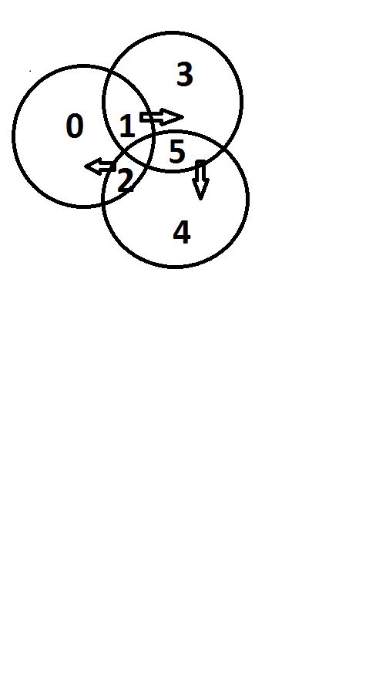
Data Structures Week 1
1
0
2
0 waits on process 1,
Process 1 on process 2 (process5)
process 2 on process 0

Slide 32
Maekawa’s algorithm-version 1
ME2. No deadlock. Unfortunately deadlock is possible! Assume 0, 1, 2 want to enter their critical sections.
From S₀= {0,1,2}, 0,2 send ack to 0, but 1 sends ack to 1;
From S₁= {1,3,5}, 1,3 send ack to 1, but 5 sends ack to 2;
From S₂= {2,4,5}, 4,5 send ack to 2, but 2 sends ack to 0;
Now, 0 waits for 1 (to send a release), 1 waits for 2 (to send a release), , and 2 waits for 0 (to send a release), . So deadlock is possible!
S₀ = {0, 1, 2}
S₁ = {1, 3, 5}
S₂ = {2, 4, 5}
S₃ = {0, 3, 4}
S₄ = {1, 4, 6}
S₅ = {0, 5, 6}
S₆ = {2, 3, 6}

Slide 33

Features
Message Complexity:
Synchronization delay =
    2*(max message transmission time) [since a release request and a reply to next queued request to be done.]
Major problem: DEADLOCK possible
Need three more types of messages (FAILED, INQUIRE, YIELD) to handle deadlock.
    Message complexity can be 5*sqrt(N)

Slide 34
Maekawa’s algorithm-Version 2
Avoiding deadlock
If processes always receive messages in increasing order of timestamp, then deadlock “could be” avoided. But this is too strong an assumption.
Version 2 uses three additional messages: At site Sk
- failed (if reply already given to someone else with higher priority)
- inquire: An inquire msg is sent by Sk when a higher priority request has reached it( to check if the request granted process Si is already in CS ). If Si has received a failed from someone else then Si will respond with a yield to Sk. Then, Sk will put Si on the queue to allow his request at a later point and will reply to the site with higher priority.

Slide 35
Maekawa’s algorithm-Version 2
- Yield (process got failed from one of the other processes so it relinquishes its desire to enter CS for now)
However if it is already in CS, it will send RELEASE only after finishing CS.s

Slide 36
Maekawa’s algorithm-Version 2
New features in version 2
Send ack and set lock as usual.
If lock is set and a request with a larger timestamp arrives, send failed (you have no chance). If the incoming request has a lower timestamp, then send inquire (are you in CS?) to the locked process.
- Receive inquire and at least one failed message → send relinquish. The recipient resets the lock.
S₀ = {0, 1, 2}
S₁ = {1, 3, 5}
S₂ = {2, 4, 5}
S₃ = {0, 3, 4}
S₄ = {1, 4, 6}
S₅ = {0, 5, 6}
S₆ = {2, 3, 6}
Contact

Slide 37
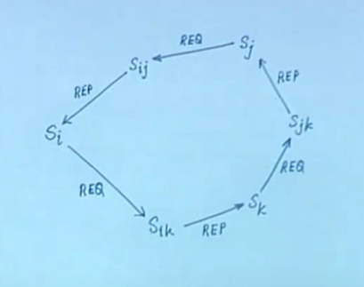
Data Structures Week 1
Say Si has highest priority.
Sij sends a fail to Sj.
Btwn Sj and Sk
if Sj has higher priority,
then Sjk sends fail to Sk.
Sik’s enquire to Sk gets a yield
and Si request to Sik has reply
Si executes and completes breaking
the deadlock
If Sk has higher priority
then Sk gets reply due to fail to Sj
Sk thus executes and completes
breaking the deadlock

